Slide 1
WATERSHED Resources for interested citizens
Gina Anderson & Jessica Hoehn

Slide 2
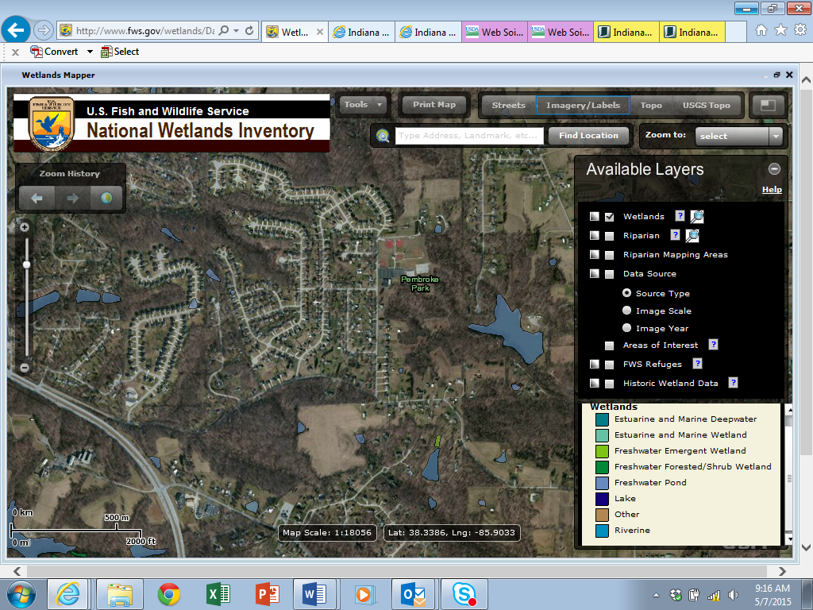
U.S. Fish and wildlife services national wetland inventory http://www.fws.gov/wetlands/Data/Mapper.html

Slide 3
U.S. Fish and Wildlife wetland inventory
The Wetlands Mapper integrates digital map data with other resource information to produce timely and relevant management and decision support tools.

Slide 4
U.S. Fish and wildlife services national wetland inventory-Terms
Estuarine and Marine Deepwater-Open water estuary, bay, sound, open ocean
Estuarine and Marine Wetland- Vegetated and non-vegetated brackish and saltwater marsh, shrubs, beach, bar, shoal or flat
Freshwater Emergent Wetland- Herbaceous march, fen, swale and wet meadow,

Slide 5
U.S. Fish and wildlife services national wetland inventory-Terms cont’d
Freshwater Forested/Shrub Wetland-Forested swamp or wetland shrub, bog, or wetland
Freshwater Pond-Pond
Lake-Lake or reservoir basin
Other- Farmed wetland, saline seep, and other miscellaneous wetland
Riverine- River or stream channel

Slide 6
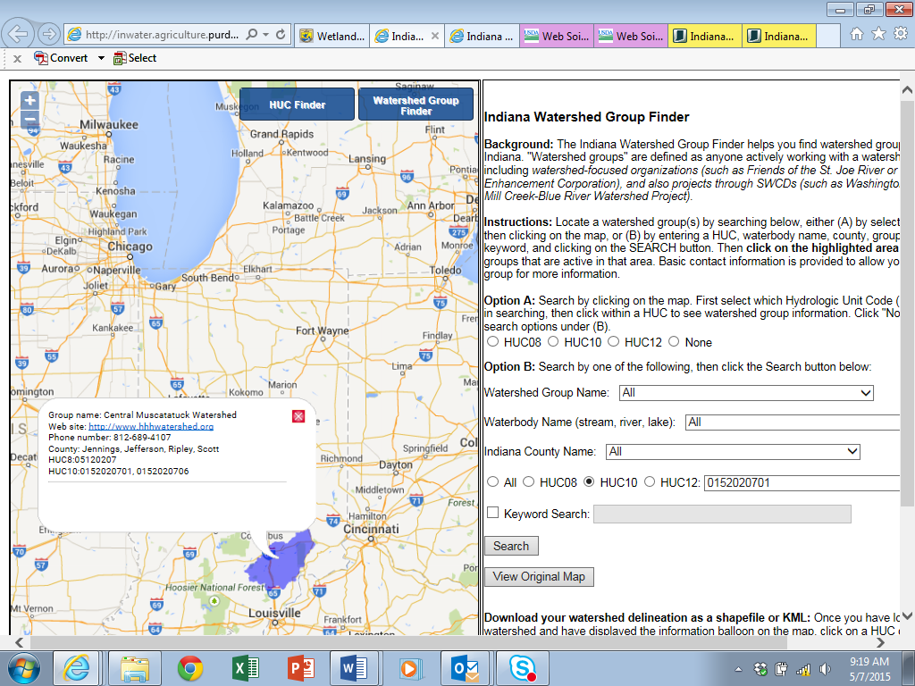
Indiana Watershed group Finder http://inwater.agriculture.purdue.edu/huc_group/

Slide 7
Indiana Watershed group Finder
The Indiana Watershed Group/HUC Finder is a website that can be used to easily find hydrologic unit codes (HUC) and watershed groups throughout the state of Indiana.
Simple step-by-step instructions found on website.

Slide 8
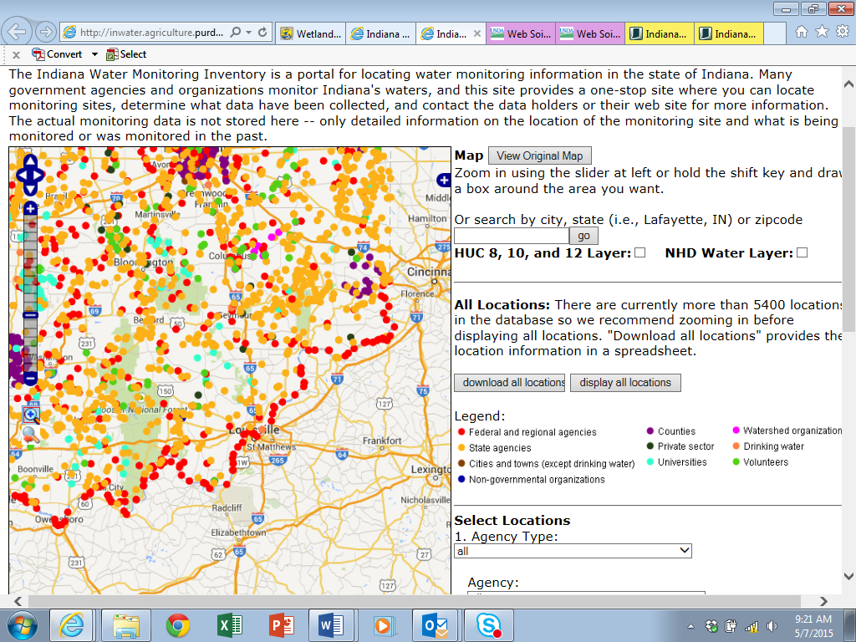
Indiana Water Monitoring Inventory: http://inwater.agriculture.purdue.edu/monitoring/

Slide 9
Indiana Water Monitoring Inventory
A tool that has collected water monitoring information from multiple sources and compiled into one location. Monitoring sites, description of data collected, and data holder contact information can be found at this website.
Actual data cannot be found on the website.
Simple step-by-step instructions found on website.

Slide 10
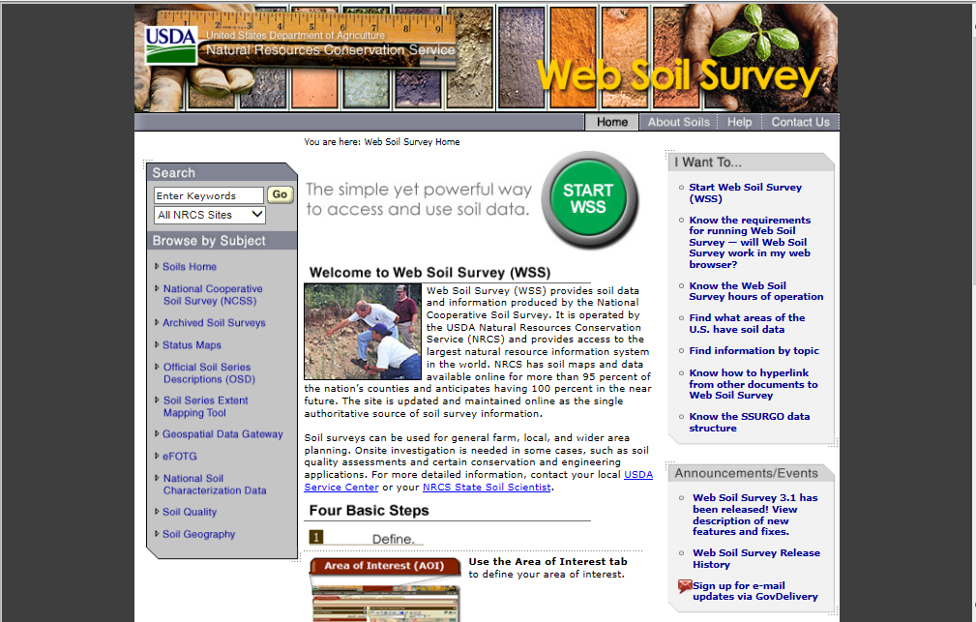
Web soil Survey: http://websoilsurvey.sc.egov.usda.gov/App/HomePage.htm

Slide 11
Wes Soil Survey
Provides soil data and information produced by the National Cooperative Soil Survey. It is operated by the USDA Natural Resources Conservation Service (NRCS) and provides access to the largest natural resource information system in the world.
Information about soils such as soil type, drainage class, septic limitations and much, much more can be obtained from this site.

Slide 12
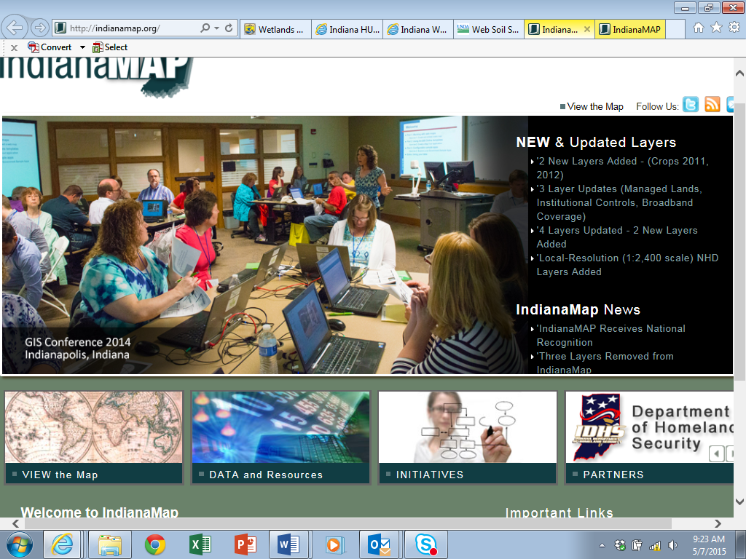
Indiana Map: http://indianamap.org/

Slide 13
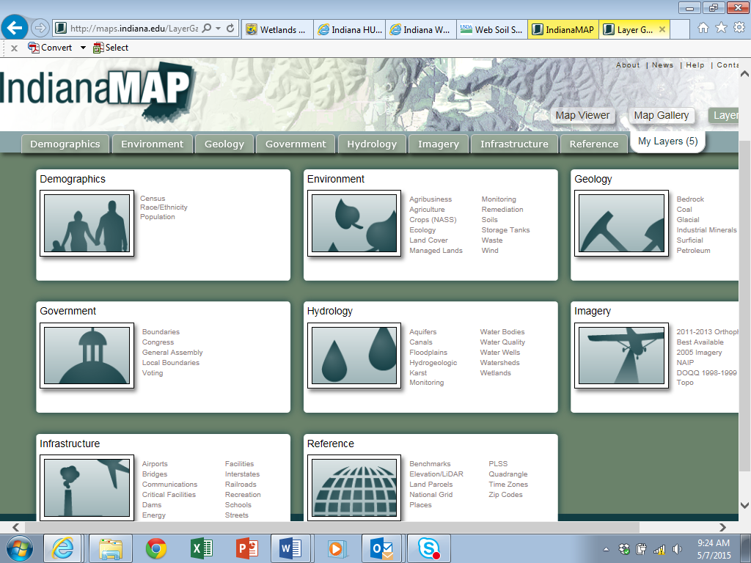
Indiana Map

Slide 14
Indiana Map:
The largest publicly available collection of Indiana geographic information system (GIS) map data. It is made possible by an alliance of partners from federal, state, local organizations and agencies, and universities.

Slide 15
Using IndianaMAP, you can:
Access easy-to-use interactive web maps from a computer or mobile device
Select from a gallery of predefined maps to view or customize
Download free GIS data and metadata
Learn about IndianaMap GIS projects, initiatives, and news”

Slide 16
Indiana Map layer gallery:
Demographics: Census, Race/Ethnicity, Population
Environment: Agribusiness, Agriculture, Crops (NASS), Ecology, Land Cover, Managed Lands, Monitoring, Remediation, Soils, Storage Tanks, Waste, Wind
Geology: Bedrock, Coal, Glacial, Industrial Minerals, Surficial, Petroleum, Physiography, Seismic, Silurian

Slide 17
Indiana map layer gallery cont’d:
Government: Boundaries, Congress, General Assembly, Local Boundaries, Voting
Hydrology: Aquifers, Canals, Floodplains, Hydrogeologic, Karst, Monitoring, Water Bodies, Water Quality, Water Wells, Watersheds, Wetlands
Imagery: 2011-2013 Orthophotos, Best Available, 2005 Imagery, NAIP, DOQQ 1998-1999, Topo
Infrastructure: Airports, Bridges, Communications, Critical Facilities, Dams, Energy, Facilities, Interstates, Railroads, Recreation, Schools, Streets
Reference: Benchmarks, Elevation/LiDAR, Land Parcels, National Grid, Places, PLSS, Quadrangle, Time Zones, Zip Codes

Slide 18
references
Indiana Finder Tools. Retrieved May 13, 2015 from http://inwater.agriculture.purdue.edu /hucgroup/.
Indiana Geological Survey. IndianaMAP. Retrieved May 15, 2015 from http://www.indianamap .org/.
Indiana Water Monitoring Inventory. Retrieved May 13, 2015 from http://inwater.agriculture. purdue.edu/monitoring/.
United States Department of Agriculture. Web Soil Survey. Retrieved May 15, 2015 from http://websoilsurvey.sc.egov.usda.gov/App/HomePage.htm
U.S. Fish and Wildlife Service. National Wetlands Inventory. Retrieved May 12, 2015 from http://www .fws.gov/wetlands/.

